Slide 1
11. Link-Based Ranking

Slide 2
Web is a Hypertext
Web documents are connected through hyperlinks
Anchor text describes content of referred document
Hyperlink is a quality signal
Page 1
Page 2
Hyper-Link
Anchor text
Notes:
Beyond the textual contents, Web documents consist also of hyperlinks. A hyperlink can be exploited for information retrieval in two ways:
The link is surrounded by some textual information that presumably refers to the content of the document the link is pointing to. Thus this text can complement the content of the referred document.
The link can also be considered as an endorsement of the referenced document by the author of the referring document. Thus the link can be used as a signal for quality and importance of the referred document.

Slide 3
Indexing Anchor Text
Anchor text is loosely defined as the text surrounding a hyperlink
Example: “You can find cheap cars here.” Anchor text: “You can find cheap cars here”
Anchor text may contain a lot of additional content on the referred page
It might be a better description of the page than the page content itself
Notes:
Anchor text can be defined in different ways. In general, it is considered as the text that is surrounding the link, and not only the text contained as part of the link tag (in the example, this text would simply be “here”.) This text can contain valuable information on the referred page and thus be very helpful in retrieval.

Slide 4
Example
When indexing a document D, include (with some weight) anchor text from links pointing to D
ethz.ch
“joint research”
bilan.ch
“EPFL startups”
Blacklist.org:
“attention: spam”
snf.ch
“eligible university”
24heures.ch
“drone valley”
1
2
EPFL home page
Fake EPFL home page
(same term frequencies as EPFL home page)
Notes:
This example illustrates the use of anchor text in retrieval. Typically a home page is very graphical and contains often very little relevant content. If we consider a home page, such as the EPFL home page, we would probably found many pages that very well characterize EPFL, such as pages mentioning topics related to research and technology transfer. Typically this links would point to the EPFL home page. Thus it would also let the home page stand out from other EPFL pages (such as pages on the laws and ordonnances of EPFL).
Assume that a malicious Internet user would create a fake EPFL home page. Then chances that such a page is referred by reputed organizations, such as SNF, is very low. On the other hand pages listing spam pages might point to such a page and indicate its true character.
Therefore it makes a lot of sense to include such anchor text in the representation of the document. This is usually done by adding it with a given weight.

Slide 5
Scoring of Anchor Text
Score anchor text with a weight depending on the authority of the anchor page’s website
E.g., if we were to assume that content from cnn.com or yahoo.com is authoritative, then trust (more) the anchor text from them
Score anchor text from other sites (domains) higher than text from the same site
non-nepotistic scoring
Notes:
To fight spam, on can adapt the weighting function to the reputation of the page that is referring. This could be done by having a directory of highly reputed sites and to give high weights to its members. A more fundamental of producing such reputation scores we will see in the following part on link-based ranking.
In order to avoid self-promotion, another method to fight link spamming is to give lower weights to links within the same site (nepotistic scoring = promoting your own family members).

Slide 6
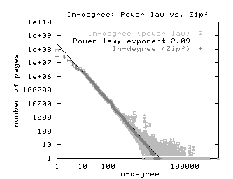
Indexing Anchor Text
Sec. 21.1.1
Can sometimes lead to unexpected effects, e.g., easily spammable
Spammers violating power laws!
Notes:
One of the risks of including anchor text is that it makes pages spammable. Malicious users could create spam pages that point to web pages and try to relate it to contents that serve their interests (e.g., higher the quality of preferred pages by adding links, lower the quality of the undesired page by attaching negative anchor text). That this can happen can be seen from looking at a statistics on the in-degree distribution of Web pages that has been produced.
The figure shows a standard log-log representation of the in-degree vs. the frequency of pages. Normally this relationship should follow a power-law, which shows in a log-log representation as a linear dependency. In real Web data, we see that this power law is violated, and that certain levels of in-degrees are over-represented. This can be attributed to link spamming, which does create moderate numbers of additional links on Web pages.
This is of course only one example of spamming techniques, and Web search engines are in a continuous “battle” against this and other forms of spam.

Slide 7
Link-based ranking: Pagerank

Slide 8
Citation Analysis
Bibliometry: analysis of citations in scientific publications
Citation frequency: how important is a paper of author?
Co-citation analysis: articles that co-cite the same articles are related
Citation indexing: who is this author cited by?
Impact factor: Authority of sources, such as journals
Notes:
The use of links in order to evaluate the quality of information sources has a long tradition, in particular in science. The scientific discipline of bibliometry is fully devoted to the problem of evaluating the quality of research through citation analysis. Different ideas can be exploited to that end:
The frequency of citations to a paper, indicating how popular / visible it is
Co-citation analysis in order to identify research working in related disciplines
Citation indexing in order to explore the profile of researchers referring to an author (as indicator of both the discipline and the quality)
Analysis of the authority of sources of scientific publications, e.g. journals, publishers, conferences. This measure can then in turn be used to weight the relevance of publications.
All these ideas could also be exploited for any other document collections that have references, in particular for Web document collections with hyperlinks.

Slide 9
Citations on the Web
Yahoo
Pinterest
Google
Sony CH
Sony D
Sony EU
Sony US
DVD expert
1
2
DVD player
DVD player
Full text retrieval result with equal ranking; which page is more relevant ?
relevance related to number of referrals (incoming links)
relevance related to number of referrals with high relevance
Notes:
When retrieving documents from the Web, the link structure bears important information on the relevance of documents. Generally speaking, a document that is referred more often by other documents through Web links, is likely to be of higher interest and therefore relevance. So a possibility to rank documents is considering the number of incoming links. Doing this allows to distinguish documents that otherwise would be ranked equally or similarly when relying on text retrieval alone.
However, when doing this, also the importance of documents having a link to the document to be ranked may be different. Therefore not only counting then number of incoming links, but also weighing the links by the relevance of documents that contain these links appears to be appropriate. The same reasoning of course again applies then for evaluating the relevance of documents pointing to the document and so forth.

Slide 10
The Web isn’t Scholarly Citation
Millions of participants, each with self interests
Spamming is widespread
Once search engines began to use links for ranking (roughly 1998), link spam grew
You can join a link farm – a group of websites that heavily link to one another
Simple link counting might not be appropriate!
Notes:
In the web, analysis of links servers not only (or necessarily) the purpose of finding authorative sources, such as in science. It also and in particular can help to fight the aforementioned problem of link spamming. When using such methods, such as in any arms race, of course counter-measures have been devised by the adversaries. These resulted in the creation of link farms, that try to boost the relevance of Web pages by creating many (artificial) links to them. So just counting incoming links is probably not such a good idea in order to evaluate the quality of a Web page.

Slide 11
Link-based Ranking: Idea
Sec. 21.2
Imagine a user doing a random walk on Web pages:
Start at a random page
At each step, leave the current page along one of the links on that page, with same probability
“In the long run” each page has a long-term visit rate - use this as the page’s score
1/3
1/3
1/3
Notes:
The fundamental idea of link-based scoring while attempting to fight spam is based on the concept of a random walker on the Web. Assume a random walker would visit a Web page. Then it would follow each f the outgoing links with equal probability. If walking for a very long time in the Web, it would have a certain fraction of visits it passes by every page.
One of the consequences of this model would be that pages that have few in-links, would be relatively infrequently visited. Since link farms usually have not many links pointing to them, in this way their influence in terms of link spamming would be moderated.

Slide 12
Random Walker Model
p_{j}
C(p_{j})
p₁
p_{N}
N is the number of Web pages
C(p) is the number of outgoing links of page p
P(p_{i}) probability to visit page p_{i}, where page p_{i} is pointed to by pages p₁ to p_{N} = relevance
p_{i}
Result
If a random walker visits a page more often it is more relevant
takes into account the number of referrals AND the relevance of referrals
Notes:
Here we describe the random walker model more formally. The long term probability of visiting a page, depends on the long-term probability of having visited a page that is referring to the page. Thus the formulation of the random walker model becomes recursive.

Slide 13
Transition Matrix for Random Walker
The definition of P(p_{i}) can be reformulated as matrix equation
The vector of page relevance values is the Eigenvector of the matrix R for the largest Eigenvalue
Notes:
In order to determine the solution to the recursive formulation of the probabilities of a random walker to visit a page, we introduce a transition probability matrix R, which captures the probability of transitioning from one page to another. We also require that the long-term probabilities of visiting a page add up to 1. With this representation the long-term visiting probabilities become the Eigenvector of matrix R. More precisely, they are the Eigenvector with the largest Eigenvalue.

Slide 14
Example
Links from p₁
P(p₁)=2/5
P(p₂)=1/5
Links to p₁
C(p₁)=2
C(p₃)=1
C(p₂)=1
P(p₃)=2/5
Link Matrix
Ranking p₁, p₃ > p₂
Notes:
This example illustrates the computation of the probabilities for visiting a specific Web page. The values C(p_{i}) correspond to the transition probabilities. They can be derived from the link matrix. The link matrix is defined as L_{ij}=1 if there is a link from p_{j} to p_{i}. The link matrix is normalized by the outdegree, by dividing the values in the columns by the sum of the values found in the column, resulting in Matrix R. The probability of a random walker being in a node is then obtained from the Eigenvector of this matrix.

Slide 15
Modified Example
Links from p₁
P(p₁)=0
P(p₂)=0
Links to p₁
C(p₁)=2
C(p₂)=1
P(p₃)=0
Link Matrix
No Ranking
Notes:
This example illustrates the problem of dead ends. We see that there exists a node p₃ that is a "sink of rank". Any random walk ends up in this sink, and therefore the other nodes do not receive any ranking weight. Consequently also the rank of sink does not. Therefore the only solution to the equation p=Rp is the zero vector.

Slide 16
Pure Random Walker Does Not Work
Sec. 21.2
The web is full of dead-ends
Random walk can get stuck in dead-ends
Makes no sense to talk about long-term visit rates
Teleporting
At a dead end, jump to a random web page
At any non-dead end, jump to a random web page with some probability (e.g. 15%)
Result: Now cannot get stuck locally, there is a long-term rate at which any page is visited
??
Notes:
A practical problem with the random walker is the fact that there exist Web pages that have no outgoing links. Thus the random walker would get stuck. To fix this, the concept of teleporting is introduced, where the random walker jumps to any randomly selected Web page. In case of arriving at a dead end, it jumps in any case, otherwise with a given probability instead of following an outgoing link.
Another problem are pages that have no incoming links: they would never be reached by the random walker, and the weight that they could provide to other pages would not be considered. Also this problem is solved by teleporting.

Slide 17
Source of Rank: Teleporting
Assumption
random walker jumps with probability 1-q to an arbitrary node
thus it can leave dead ends and nodes without incoming links are reached
PageRank method
p_{j}
C(p_{j})
p₁
p_{N}
q
1-q
p_{i}
N nodes
Notes:
To avoid the previously described problem, we add a "source of rank". The idea is that a random walker in each step can, rather than following a link, jump to any page with probability 1-q. Therefore the random walker can leave pages that have no outgoing links and also pages without incoming links can be reached by the random walk and give weight to other pages. In the mathematical formulation of the random walk this is resulting in an additional a term for the source of rank. Since at each step the random walker makes a jump with probability 1-q and any of the N pages is reached with the same probability the additional term is (1-q)/N. Reformulating this again as matrix equation requires adding a NxN Matrix E with all entries being 1/N. This is equivalent to saying that with probability 1/N transitions among any pairs of nodes (including transition from a node to itself) are performed. Since the vector p has norm 1, i.e., the sum of the components is exactly 1, E.p=e, where e is the unit vector, the matrix equation can be reformulated in the second form shown below. The method described is called PageRank and is used by Google. By modifying the values of the matrix E also a priori knowledge about the relative importance of pages can be added to the algorithm.

Slide 18
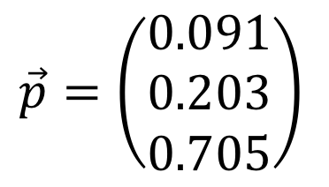
Modified Example
P(p₁)=0.123
P(p₂)=0.275
C(p₁)=2
C(p₂)=1
P(p₃)=0.953
$$\vec{p}=\left(\begin{matrix}0.091 \\ 0.203 \\ 0.705\end{matrix}\right)$$
Ranking p₃ > p₂ > p₁
Notes:
With the modification of rank computation using a source of rank, we obtain for our example again a non-trivial ranking which appears to be appropriate.
The 1-norm of p is {0.0912349, 0.203606, 0.705159}.

Slide 19
Practical Computation of PageRank
Iterative computation
ε termination criterion
s arbitrary start vector, e.g. s = e
Notes:
For the practical computation of the PageRank ranking an iterative approach can be used. It is derived from the second form of the formulation of the visiting probabilities of the random walker that we have given. The vector e used to add a source of rank has not necessarily to assign uniform weights to all pages, but might reflect itself a ranking of Web pages.

Slide 20
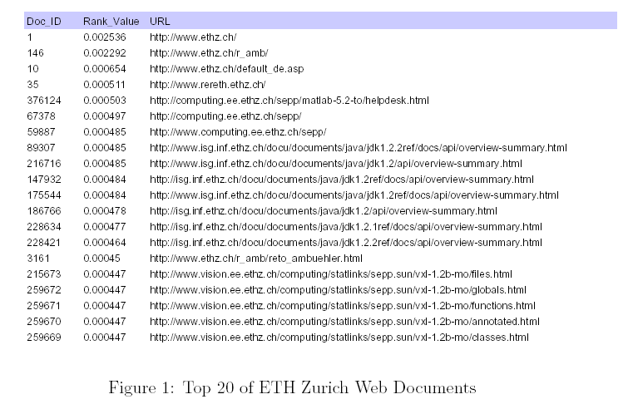
Example: ETHZ Page Rank
Notes:
These are the top documents from the PageRank ranking of all Web pages at ETHZ (Data from 2001). It is interesting to see that documents related to Java documentation receive high ranking values. This is related to the fact that these documents have many internal cross-references.

Slide 21
Web Search
PageRank is part of the ranking method used by Google
Compute the global PageRank for all Web pages
Given a keyword-based query retrieve a ranked set of documents using standard text retrieval methods
Merge the ranking with the result of PageRank to both achieve high precision (text retrieval) and high quality (PageRank)
Google uses also many other methods to improve ranking
Technical challenges
Crawling the Web
Efficient computation of Page Rank for large link databases
Combination with other ranking methods (text)
Notes:
PageRank is used as one metrics to rank result documents in Google. Essentially Google uses text retrieval methods to retrieve relevant documents and then applies PageRank to create a more appropriate ranking. Google uses also many other methods to improve ranking, e.g., by giving different weights to different parts of Web documents and user relevance feedbacks. For example, title elements are given higher weight. The details of the ranking methods are trade secrets of the Web search engine providers.
Other issues that Web search engines have to deal with, are crawling the Web, which requires techniques that can explore the Web without revisiting pages too frequently. Also the enormous size of the document and link database poses implementation challenges in order to keep the ranking computations scalable. One of the outcomes of solving these challenges are the recent “cloud computing” infrastructures, which are large-scale computing clusters constructed from commodity hardware.

Slide 22
The relevance determined using the random walker model corresponds to
The number of steps a random walker needs to reach a page
The probability that the random walker visits the page in the long term
The number of incoming links a random walker can use to visit the page
The probability that the random walker will visit once the page

Slide 23
Consider a random jump matrix with entries 1/3 in the first column and 0 otherwise. It means
A random walker can always leave node 1 even without outgoing edges
A random walker can always reach node 1, even without incoming edges
A random walker can always leave node 2, even without outgoing edges
none of the above

Slide 24
Link-based ranking: HITS

Slide 25
Hyperlink-Induced Topic Search (HITS)
Sec. 21.3
Key Idea: in response to a query, instead of an ordered list of pages, find two sets of inter-related pages:
Hub pages are good lists of links on a subject
e.g., “World top universities”
Authorative pages are referred recurrently on good hubs on the subject
e.g., “EPFL”
Best suited for “broad topic” queries rather than for page-finding queries
Understand common perception of quality
Notes:
Hub-Authority ranking identifies not only pages that have a high authority, as measured by the number of incoming links, but also pages that have a substantial "referential" value, having many outgoing links (to pages of high importance). Different to the PageRank algorithm this technique has been originally proposed to post-process query results (rather than to rank pages from the complete Web graph). It can be used as an add-on to existing search engines, but as well as an alternative to the PageRank method.

Slide 26
Hub-Authority Ranking
Approach
Hubs are pages that point to many/relevant authorities
Authorities are pages that are pointed to by many/relevant hubs
Hubs
e.g. QS World, THE , Shanghai Ranking
page with large in-degree
e.g. EPFL
Authorities
e.g. EPFL, MIT, Stanford, ETHZ
Notes:
In order to realize the idea of distinguish authorities from hubs a simple approach is taken. Hub pages are consider as those that are referred a lot by authority pages and vice versa. The example illustrates of how this would ideally separate authority pages, in the case of universities well known universities, from hub pages, such as university ranking and portal sites.

Slide 27
Computing Hubs and Authorities
Sec. 21.3
Repeat the following updates, for all p
Normalize values (scaling)
p_{i}
p_{i}
Notes:
More precisely, the scores are recomputed by simply adding the scores of all incoming edges. For computing authority scores this is the hub scores and for hub scores the authority scores. In order to avoid that the scores grow continuously, they are rescaled to in each step, by normalizing the score vectors to one.

Slide 28
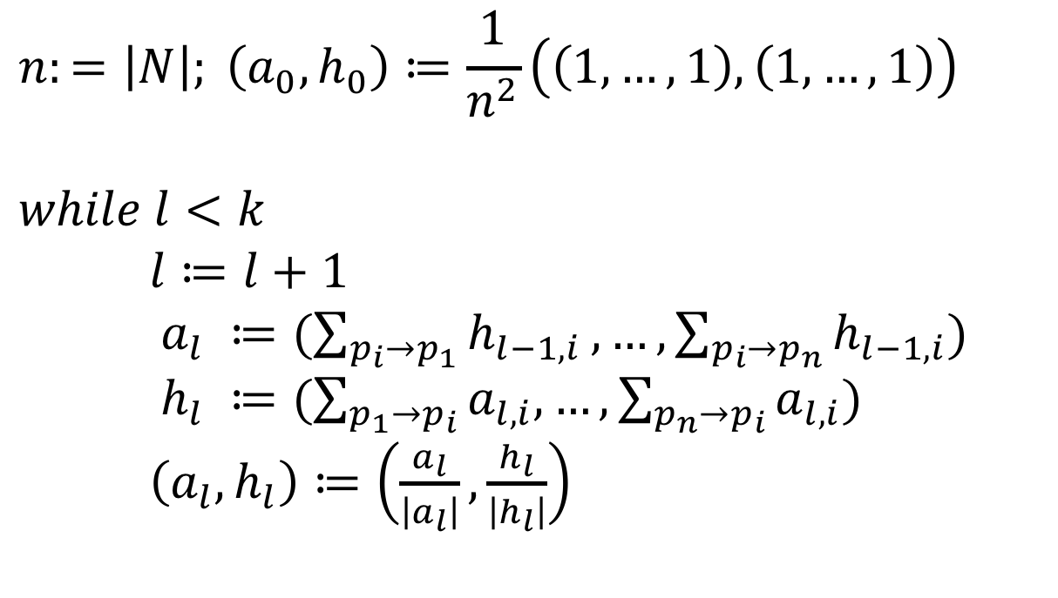
HITS algorithm
$$n:=\left|N\right|; \left(a_{0},h_{0}\right)≔\frac{1}{n^{2}}\left(\left(1,…,1\right),\left(1,…,1\right)\right)$$
$$while l<k$$ $l≔l+1$ $a_{l} ≔(\sum_{p_{i}→p_{1}}{h_{l−1,i}},…,\sum_{p_{i}→p_{n}}{h_{l−1,i}})$ $h_{l} ≔(\sum_{p_{1}→p_{i}}{a_{l,i},…,\sum_{p_{n}→p_{i}}{a_{l,i}})}$ $\left(a_{l},h_{l}\right)≔\left(\frac{a_{l}}{\left|a_{l}\right|},\frac{h_{l}}{\left|h_{l}\right|}\right)$
In practice, 5 iterations
sufficient to converge!
Notes:
As for PageRank the Hub/Authority values can be iteratively computed. x corresponds to the authority weight and y to the hub weight. At each iteration the values are renormalized to length 1.

Slide 29
Convergence of HITS
n x n link matrix L^{t}
Up to normalization
h = La, a = L^{t}h, thus a* is an Eigenvector of LL^{t}
h* is an Eigenvector of L^{t}L
1 2 3
1
2
1
2
3
0 1 0
1 1 1
3
1 0 0
Notes:
We can interpret the iterative algorithm for computing HITS in terms of computing Eigenvectors for the link matrix. If L is the link matrix then the computation of a from h is defined as a=Lh and the computation of h from a is defined as h=L^{t}a. Therefore a*, the authority vector obtained after convergence, is the principal Eigenvector of Matrix LL^{t} and h*, the hub vector obtained after convergence, is the principal Eigenvector of matrix L^{t}L.
Remains the question whether this algorithm always converges. The algorithm is a particular algorithm for computing eigenvectors: the power iteration method. It is proven to converge against the principal Eigenvalue. Important is the normalization of the vectors obtained in each step.

Slide 30
When computing HITS, the initial values
Are set all to 1
Are set all to 1/n
Are set all to 1/n^2
Are chosen randomly

Slide 31

If the first column of matrix L is (0,1,1,1) and all other entries are 0 then the authority values
$\left(0,1,1,1\right)$
$\left(0,1/{\sqrt{3}},1/{\sqrt{3}},1/{\sqrt{3}}\right)$
$\left(1,1/{\sqrt{3}},1/{\sqrt{3}},1/{\sqrt{3}}\right)$
$\left(1,0,0,0\right)$

Slide 32
Practical Implementation
Sec. 21.3
Apply HITS in the context of a query
Given a query (e.g. “EPFL”), obtain all pages mentioning the query: call this the root set of pages.
Add page that either
points to a page in the root set, or
is pointed to by a page in the root set.
Use this set as base set
Compute HITS on the base set
Root
set
Base set
Notes:
One possible application of HITS is to compute the ranking on the complete Web Graph, as it is done with PageRank. Another way to use it (and this is how it was initially conceived), is to apply it in the context of a given query, to rerank the results by promoting results with high authority and hub values. In order to perform this operation, first all results for a query are retrieved (using a standard text retrieval model). Then the neighboring pages (either pointing to a result page, or referred by a result page) are added to the set of pages, which is then called the base set. HITS is then computed on the base set. This makes sense, as in this way we both consider referred pages and referring pages for the relevant documents, which helps to identify both hubs and authorities.

Slide 33
Sample Results Obtained
Notes:
These are two example results that have been obtained by applying this method. (It is interesting to compare those to the ones you would obtain by using a search engine alone). In particular Gamelan will not show up in the result, whereas the Java Sun page is usually among the top ranked.

Slide 34
HITS Conclusions
Potential issues
Topic Drift: off-topic pages can cause off-topic “authorities” to be returned
Mutually Reinforcing Affiliates: clusters of affiliated pages/sites can boost each others’scores
Social Network Analysis
PageRank and HITs are examples of Social Network (SN) Analysis algorithms
SNs contain a lot of other interesting structure (see later)
Implementation
How to efficiently obtain the base set?
Notes:
Similarly as for PageRank, the HITS algorithm is also vulnerable structural anomalies of the link structure, be it caused by conscious manipulation or by chance. Topic drift would imply that the set of base pages refers to a topic that is different from the original intended one, expressed by a search query. For example, if we would search for top European universities, it could well happen that the topic would drift to top US universities, when ranking hubs come into play that strongly refer to those. We could have also clusters of related pages, that in the iterative computation mutually boost each others scores, and thus give too high weight to pages that would not merit it. This problem is similar to the one of link spamming with link farms.
In terms of implementation, link-based ranking algorithms require the capability to efficiently retrieve the link graph for the Web. This problem is addressed by so-called connectivity servers that we will introduce next.

Slide 35
Link-based Ranking: Link Indexing

Slide 36
Connectivity Server
Sec. 20.4
Support for fast queries on the web graph
Which URLs point to a given URL?
Which URLs does a given URL point to?
Stores mappings in memory from
URL to outlinks, URL to inlinks
Applications
Link analysis (PageRank, HITS)
Web crawl control
Web graph analysis
Connectivity, crawl optimization
Notes:
In order to efficiently analyze the Web graph the Web links need to stored in a database, respectively index. A connectivity server is such an index. In essence, it stores for each URL all the URLs that the Web page at the URL is pointing to, and the URLs of other Web pages that point to this URL. Apart from link-based ranking algorithms as described before the applications are manifold.

Slide 37
Adjacency Lists
Sec. 20.4
The set of URLs a node is pointing to (or pointed to) sorted in lexicographical order
Example: outgoing links from www.epfl.ch
actu.epfl.ch/feeds/rss/mediacom/en/
bachelor.epfl.ch/studies
futuretudiant.epfl.ch/en
futuretudiant.epfl.ch/mobility
master.epfl.ch/page-94489-en.html
phd.epfl.ch/home
www.epfl.ch/navigate.en.shtml
Notes:
A connectivity server has to store all outgoing (and incoming) links to a web page. For example, the home page of EPFL contains a large set of outgoing links, some of which are shown here. As a first step, the lists of links are sorted in lexicographical order. As a result we obtain the adjacency list, which is similar to the posting list of a document.

Slide 38
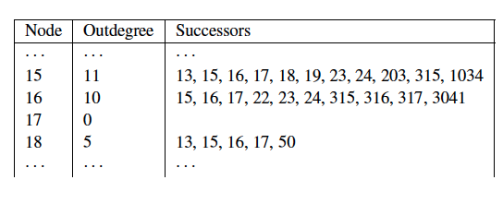
Representation of Adjacency Lists
Assume each URL represented by an integer
For a 4 billion page web, we need 32 bits per node
Naively, this demands 64 bits to represent each hyperlink (source and destination node); on average 10 links per page
For the current Web: 320 GB
Can we do better (for main memory storage)?
Notes:
As a first means to optimize the representation of adjacency lists, we represent each URL by one integer, instead of storing its textual form. From this we can estimate that for the current Web, we need 320 GB to represent all links:
The current (crawled) Web has about 4 billion pages (http://www.worldwidewebsize.com/)
It is estimated that a page contains on average 10 links
We need 32 bits for each URL, which demands 64 bits for the storage of a single link.
Even with large memories this still a significant index size. In the following, we will show how to get this down to approximately ~3 bits/link which makes the index much more manageable. This will be achieved by systematically compressing the adjacency lists.

Slide 39
Properties of Adjacency Lists
Locality (within lists)
Most links contained in a page have a navigational nature, thus their indices are close in lexicographical order
E.g. for www.epfl.ch
futuretudiant.epfl.ch/en
futuretudiant.epfl.ch/mobility
Similarity (between lists)
Observation 1: Either two lists have almost nothing in common, or they share large segments of their lists
Observation 2: Pages that occur close to each other in lexicographic order tend to have similar lists
E.g. futuretudiant.epfl.ch/en and futuretudiant.epfl.ch/mobility
Notes:
For compressing adjacency lists we base ourselves on the following observations:
Locality. Most links contained in a page have a navigational nature: they lead the user to some other pages within the same host (as we can see clearly from the example of the EPFL home page). If we compare the source and target URLs of these links, we observe that they share often a long common prefix. Thus, if URLs are sorted lexicographically, the index of source and target are close to each other. Locality is a property of a list, thus addresses intra-list similarity.
Similarity. Pages that occur close to each other (in lexicographic order) tend to have many common successors. This is because many navigational links are the same within the same local cluster of pages, and even non-navigational links are often copied from one page to another within the same host. Similarity is a property concerning different lists, thus addresses inter-list similarity.

Slide 40
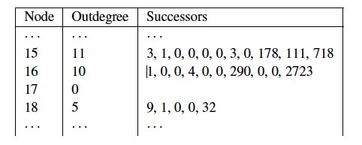
Exploiting Locality
Use Gap Encoding (as in inverted files)
S(x) = (s₁,…,s_{k}) will be represented as (s₁-x, s₂-s₁-1,…,s_{k}-s_{k-1}-1)
Use of varying length encoding
Notes:
Locality can be exploited in a way analogous of how compression of posting lists for text indexing has been performed. Instead of storing the absolute values of the URL identifiers, differences are stored. In other words, we perform gap encoding. The resulting differences are then encoded using a varying length compression scheme, such as gamma coding.

Slide 41
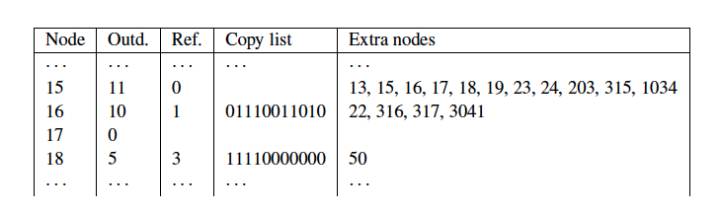
Exploiting Similarity
Copy data from similar lists (exploit observation 1)
Reference list: reference to another list
Searched in a neighboring window of nodes (exploit observation 2)
Copy list: bitmap indicates nodes copied from reference list
Extra nodes: additional nodes not in reference list
Result: about 3 bytes / link (with some further compression)
Notes:
For exploiting similarity we apply a similar idea as gap encoding, but now applied to the differences among different adjacency lists. If we consider a reference list (in the example the list of Node 15), subsequent adjacency lists can story a bitlist that indicates which nodes of the reference lists are retained in the subsequent adjacency list, and which are not. 0 indicates that the node in the reference lists is not retained, and 1 indicates that it is retained. Since the subsequent adjacency list can also contain other nodes, that are not stored in the reference list, those extra nodes are stored explicitly.
Candidates for potential reference lists are searched among neighboring lists using a window of predefined size. The choice of the window size is critical, as larger windows increase chances of finding good candidates, but also increase the cost of compression
Together with some further compression applied to the copy lists and the extra nodes, this index compression achieves about 3 Bytes/link cost in the representation of the Web graph.

Slide 42
When compressing the adjacency list of an URL, a reference list
Is chosen from neighboring URLs that can be reached in a small number of hops
May contain URLs not occurring in the current page
Lists all URLs not contained in the current page
All of the above

Slide 43
Which is true?
Exploiting locality with gap encoding may increase the size of an adjacency list
Exploiting similarity with reference lists may increase the size of an adjacency list
Both of the above is true
None of the above is true

Slide 44
References
Course material based on
Christopher D. Manning, Prabhakar Raghavan and Hinrich Schütze, Introduction to Information Retrieval, Cambridge University Press. 2008 (http://www-nlp.stanford.edu/IR-book/)
Course Information Retrieval by TU Munich (http://www.cis.lmu.de/~hs/teach/14s/ir/)
http://videolectures.net/deeplearning2015_manning_language_vectors/
Relevant articles
Mikolov, Tomas, et al. "Distributed representations of words and phrases and their compositionality." Advances in neural information processing systems. 2013.
Goldberg, Yoav, and Omer Levy. "word2vec explained: Deriving mikolov et al.'s negative-sampling word-embedding method." arXiv preprint arXiv:1402.3722 (2014).

Slide 45
References
Relevant articles
Sergey Brin , Lawrence Page, The anatomy of a large-scale hypertextual Web search engine, Computer Networks and ISDN Systems, v.30 n.1-7, p.107-117, April 1, 1998.
Jon M. Kleinberg: Authoritative Sources in a Hyperlinked Environment. JACM 46(5): 604-632 (1999)
Boldi, Paolo, and Sebastiano Vigna. "The webgraph framework I: compression techniques." Proceedings of the 13th international conference on World Wide Web. ACM, 2004.

